Slide 1
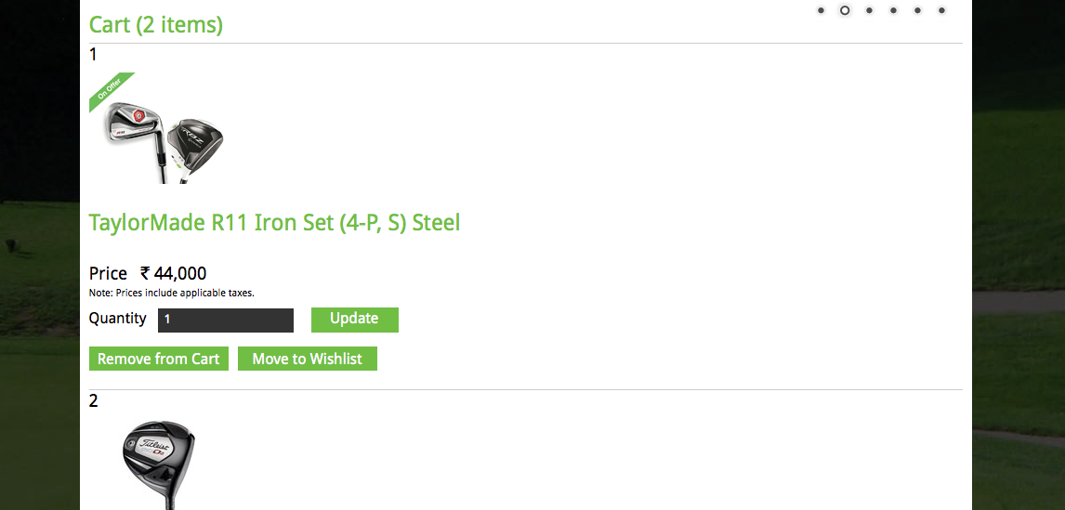
Please add
Product availability status and shipping confirmation will be communicated to you shortly after you place your order.

